Slide 1

PEA – Final Project
Jaskaran ram - 10735884 - 2023 TYPE B Marco Gribaudo

Slide 2
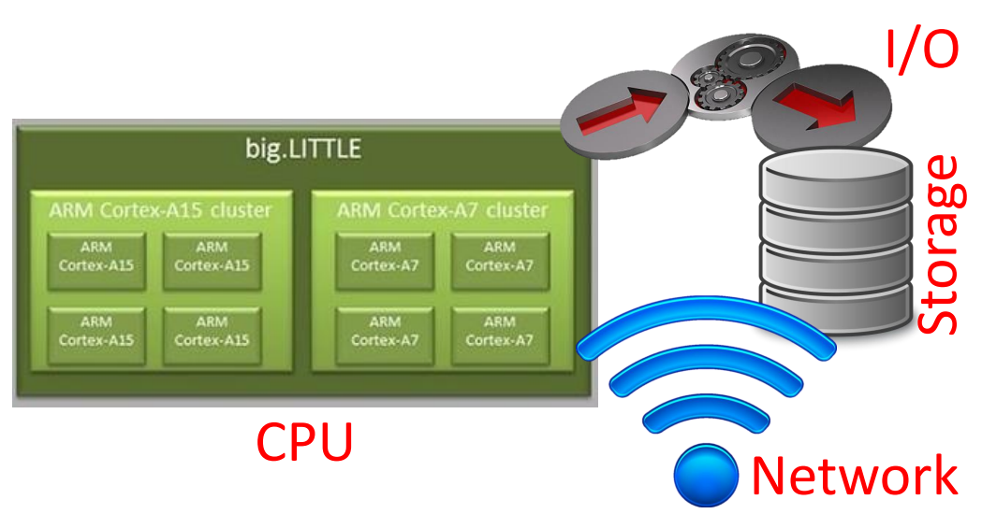

Goal of the project
Performance of a Big-Little architecture
Determine the best assignment probability distribution of tasks:
Test a few alternatives of probabilities of assigning a heavy computation task to an efficiency core and of assigning low computation task to a high-performance core.
Determine the system throughput in each scenario.

Slide 3
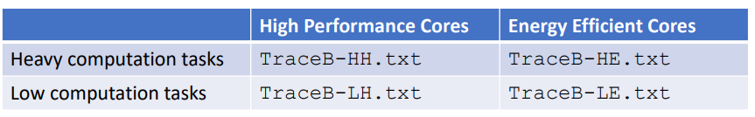
Characteristics of the model
A system characterized by a Big-Little architecture is characterized by 4 high performance cores, and 8 energy efficient cores.
It is used by NB = 10 heavy computation tasks, and NL = 32 low computation tasks.
The scheduler will mainly schedule heavy computation tasks on the high-performance cores, while low computation tasks on the energy efficient cores. However, to better use the resources, there is also a small probability that tasks will be assigned the other way round
The execution times of the tasks on the cores are collected in the following traces (all expressed in sec):

Slide 4
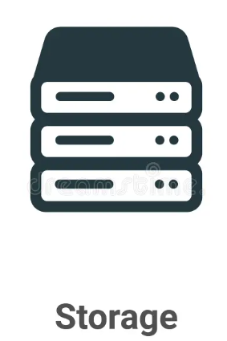


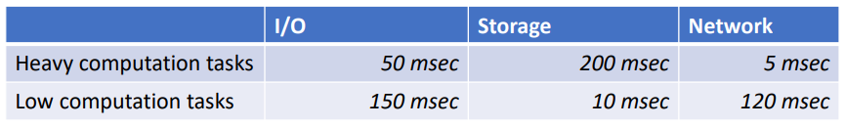
Other components
All these components can be considered working in processor sharing, with an exponential service time (different per type of job), whose average is described in these tables:

Slide 5


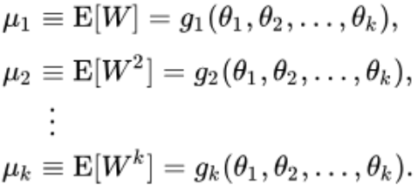
Fitting
By means of MATLAB and having at disposal samples of the durations of the corresponding execution times, I was able to define the characteristics of the various departments, exploiting the method of moments and fitting the traces according to several distributions, such as Uniform, Exponential, Hyper-Exponential, Hypo-Exponential and Erlang (they were enough to fit well). Then, looking at the coefficient of variation and at the curves in the graph I chose the most appropriate rate for each of the traces
Method of moments is used to determine the best parameters producing samples with characteristics similar to the one measured in the real trace

Slide 6
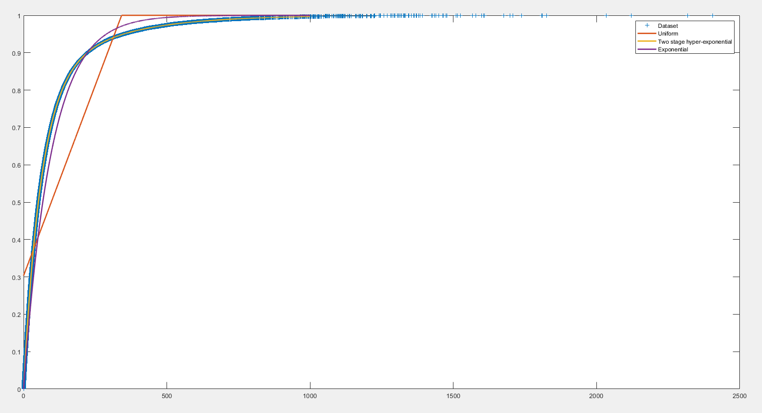
Fitting 1 - He
Heavy Computations
Energy Efficient cores
Moments:
Moment: 96.5605
Moment: 29425.2
Moment: 1.83159e+07
CV: 1.46829
Distribution:
2 stages hyper-exponential
p = 0.20066
λ1 = 0.00411398
λ2 = 0.0167277

Slide 7
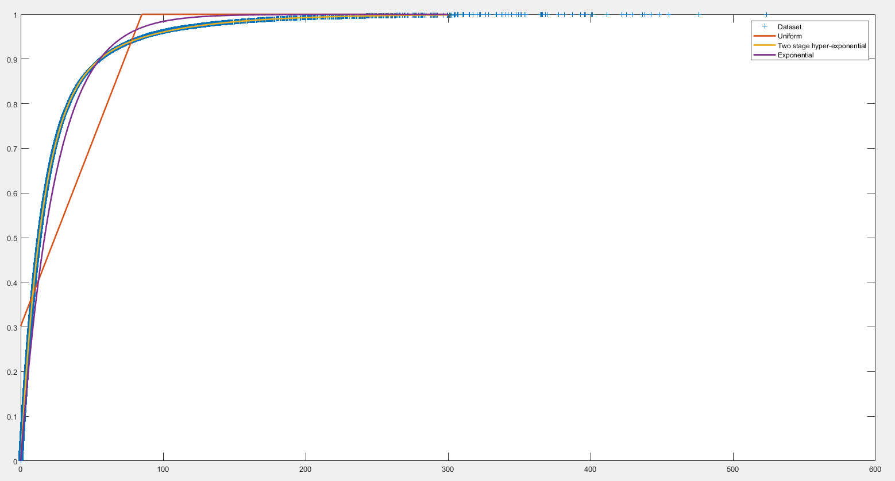
Fitting 11 - HH
Heavy Computations
High Performance cores
Moments:
Moment: 24.1255
Moment: 1820.78
Moment: 278560
CV: 1.45886
Distribution:
2 stages hyper-exponential
p = 0.206686
λ1 = 0.0167711
λ2 = 0.0672208

Slide 8
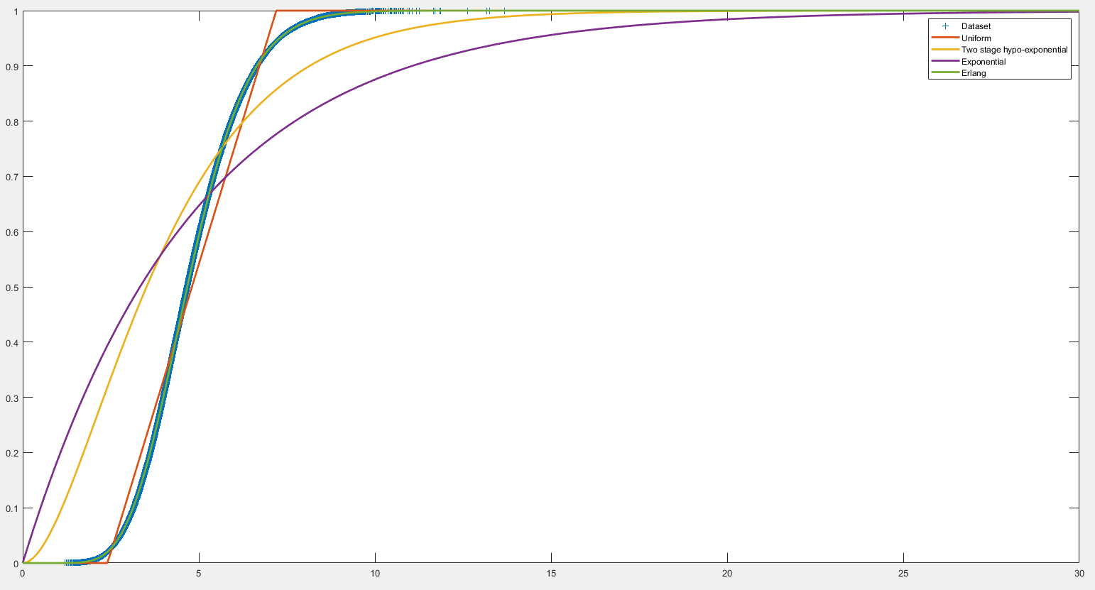
Fitting 111 - Le
Low Computations
Energy Efficient cores
Moments:
Moment: 4.80413
Moment: 24.9919
Moment: 139.942
CV: 0.28784
Distribution:
Erlang k = 12
λ = 2.49785

Slide 9
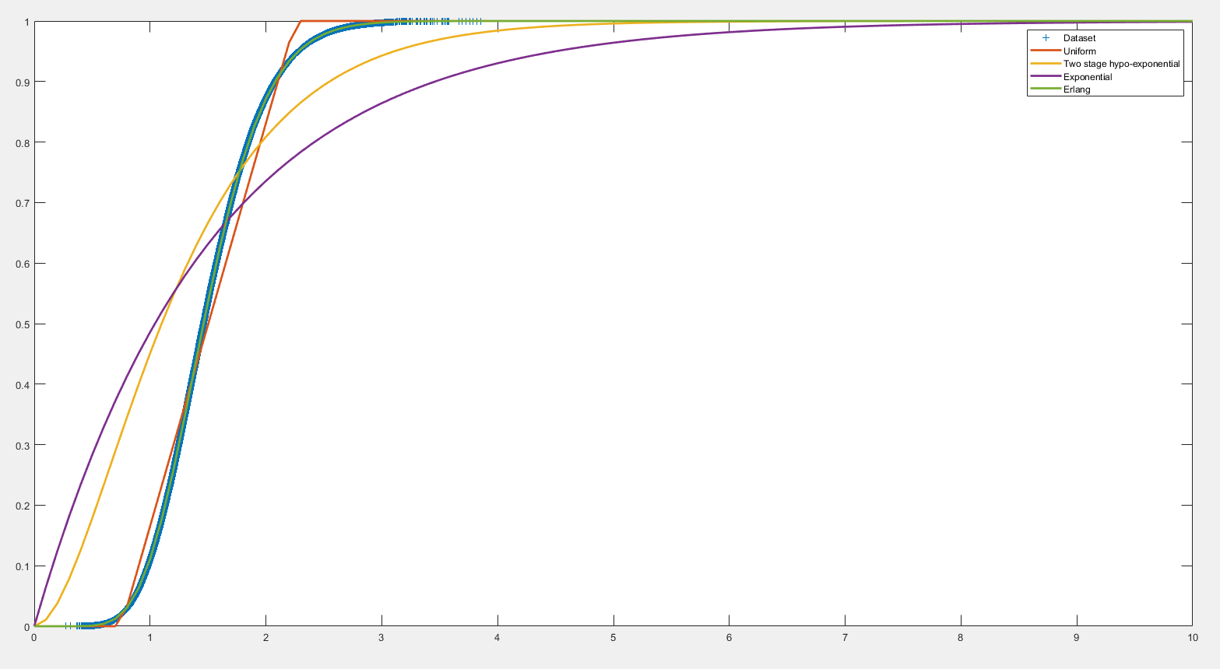
Fitting 1V - LH
Low Computations
High Performance cores
Moments:
Moment: 1.5025
Moment: 2.44536
Moment: 4.28698
CV: 0.288477
Distribution:
Erlang k = 12
λ = 7.98671

Slide 10
Model Definition
I modeled my components using JMT's JSIMgraph tool, allowing me to synthesize separable models—a system in which the order of components is irrelevant.
All components operate under Processor Sharing with a defined Service Time. Concerning the Input/Output, Storage, and Network components, I simply expressed the parameters of the exponential distribution provided in the text. For the High Performance/Energy Efficient Cores components, I estimated the probabilistic distribution using the fitting technique, as explained in previous steps.
As mentioned earlier, this is a closed model with precisely 10 Heavy tasks and 32 Low computation tasks, for which I created two Closed classes with their respective populations.
The most critical aspect pertains to routing, where I evaluated various scenarios to optimize the system's Throughput (and also Response Time). In the next slides there are various scenarios studied.

Slide 11
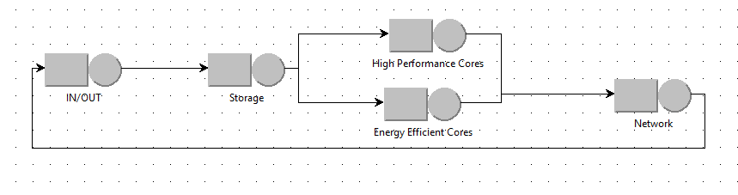
MODEL DESIGN
I could have added a router but it would have been superfluous since I can do the routing with any component.
Using JMT's JSIMgraph

Slide 12
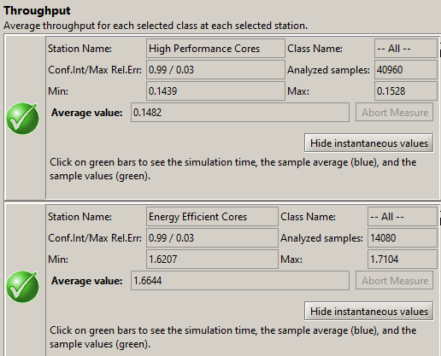
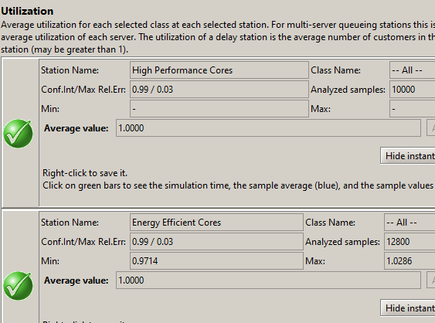
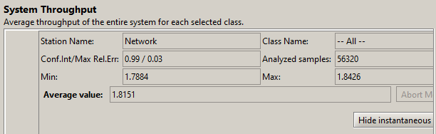
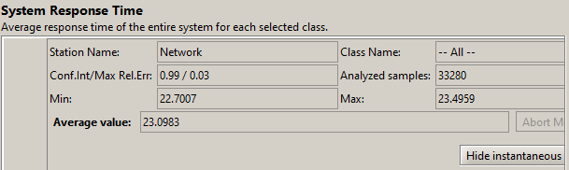
Performance indices analyzed
PROBABILITIES : all Heavy Tasks on High Performance and Light Tasks on Energy Efficient
BAD ROUTING CONFIGURATION,
even it represents the main indications about routing

Slide 13
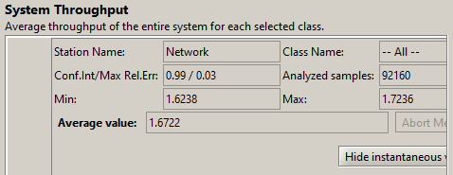
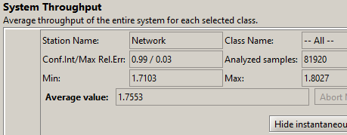
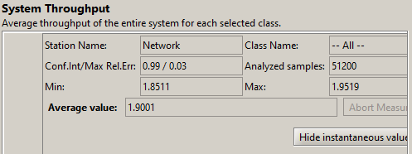
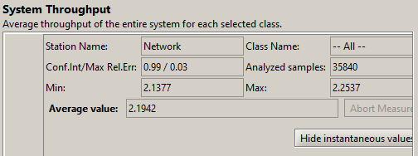
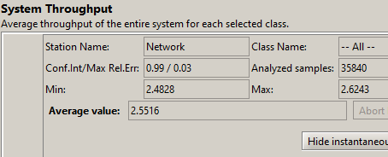
Performance indices analyzed
Different PROBABILITIES
HH: 0.9
HE: 0.1
LH: 0.1 LE: 0.9
HH: 0.8
HE: 0.2
LH: 0.2 LE: 0.8
HH: 0.7
HE: 0.3
LH: 0.3 LE: 0.7
Worst combination
HH: 0.6
HE: 0.4
LH: 0.4 LE: 0.6
HH: 0.5
HE: 0.5
LH: 0.5 LE: 0.5

Slide 14
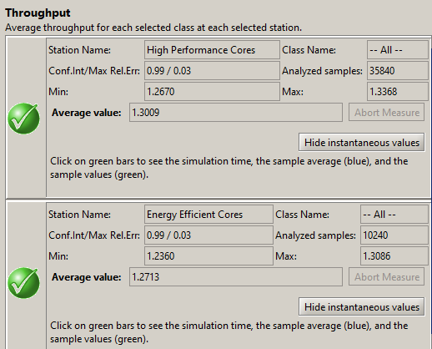
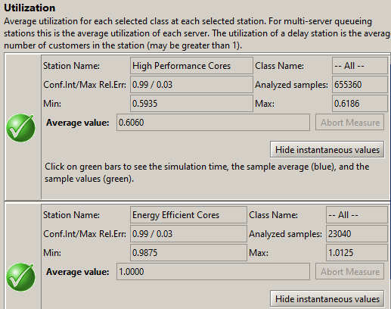
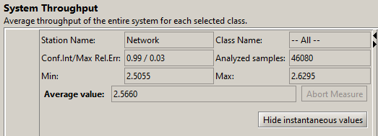
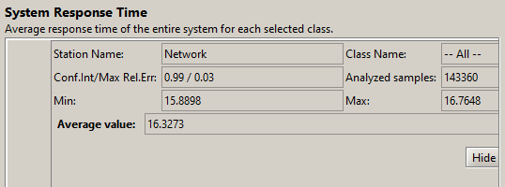
Performance indices analyzed
HH: 0.5
HE: 0.5
LH: 0.5 LE: 0.5
RANDOM ROUTING equals to
Still not optimized (for example Utilization)

Slide 15
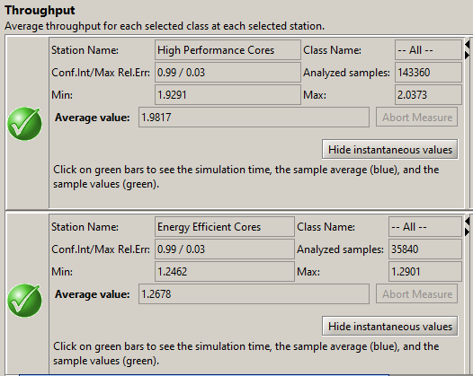
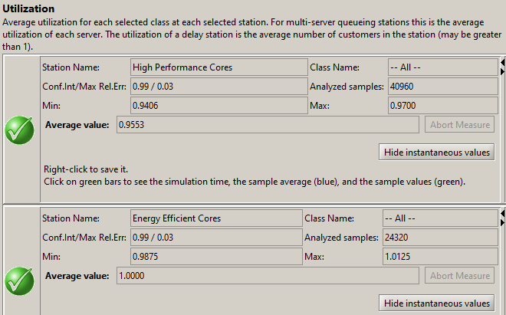
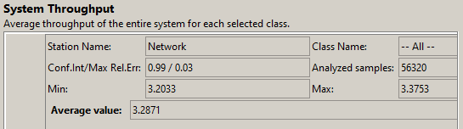
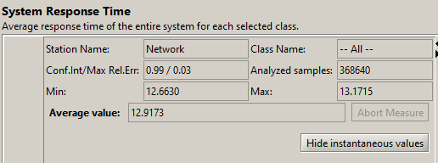
Performance indices analyzed
LEAST UTILIZATION
It does not comply with the routing directives but is definitely more performing

Slide 16
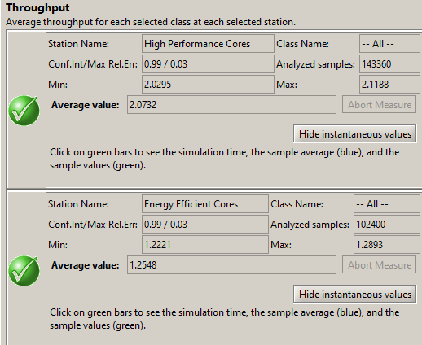
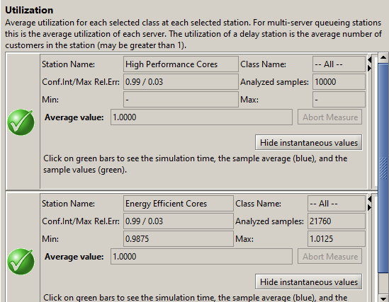
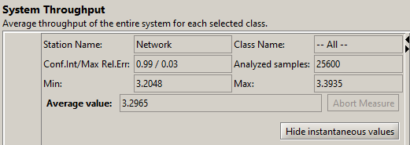
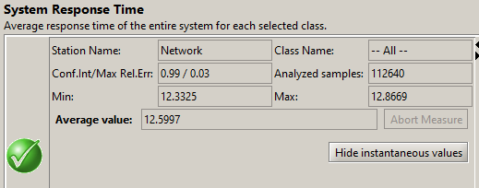
Performance indices analyzed
JOIN THE SHORTEST QUEUE
BEST ROUTING CONFIGURATION!
Same annotations as last one but a slight improvement of performance

Slide 17
Conclusions
I have studied and analyzed four scenarios, all with a confidence interval of 99% and a maximum relative error of 3%. I have explored four different routing methods:
Core Type-Based Routing:
All heavy tasks are executed on high-performance cores, while light tasks are handled by energy-efficient cores (Configuration Requested but not well performing)
it would seem that the more I am routing towards reversing the tasks by changing the probabilities, the better the Throughput system performs, but it deviates completely from that small percentage of probability that it should have represented as indicated by the directives.
Random Routing:
This method performs significantly better than the absolute first approach but still has space for optimization. (for example for the Utilization)
"Least Utilization" Approach:
Jobs are routed to the station with the smallest utilization.
This configuration has proven to be one of the most efficient.
"Join the Shortest Queue" Approach:
This configuration has demonstrated to ensure the highest system Throughput and a better average response time.
In summary, after analyzing the four scenarios, the "Join the Shortest Queue" approach has emerged as the most promising, ensuring maximum system Throughput and optimal average response time, even it doesn’t comply with the routing directives

Slide 18

Thanks
Jaskaran.ram@mail.polimi.it

